Slide 1
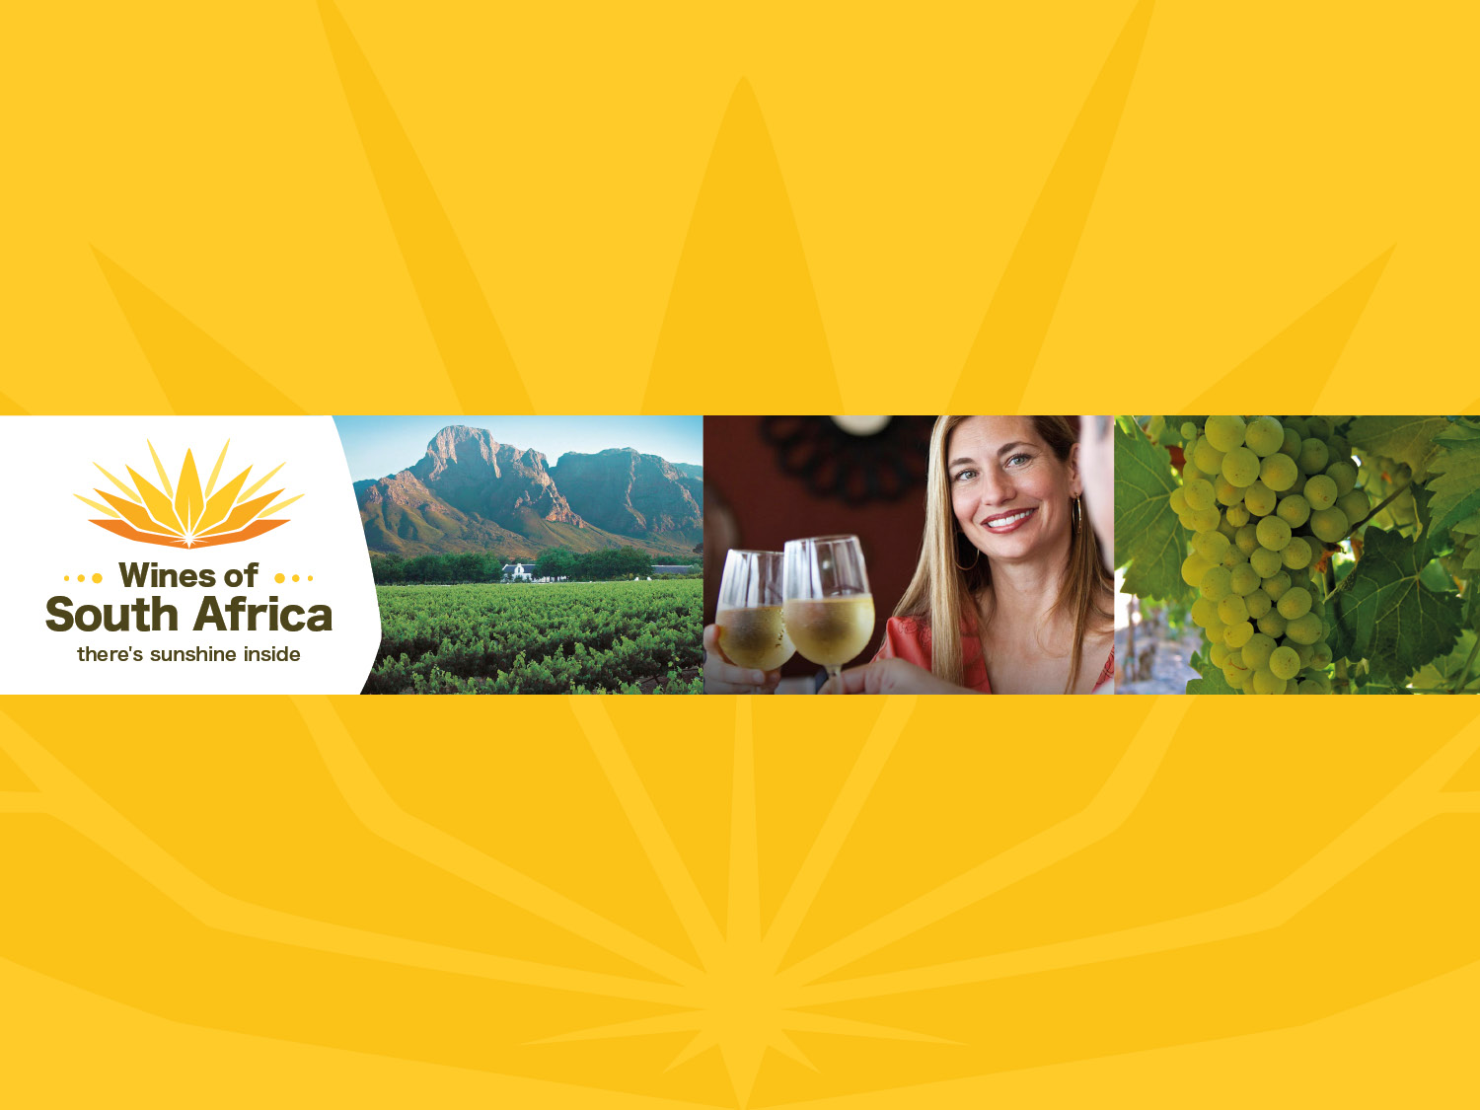
CHENIN BLANC

Slide 2
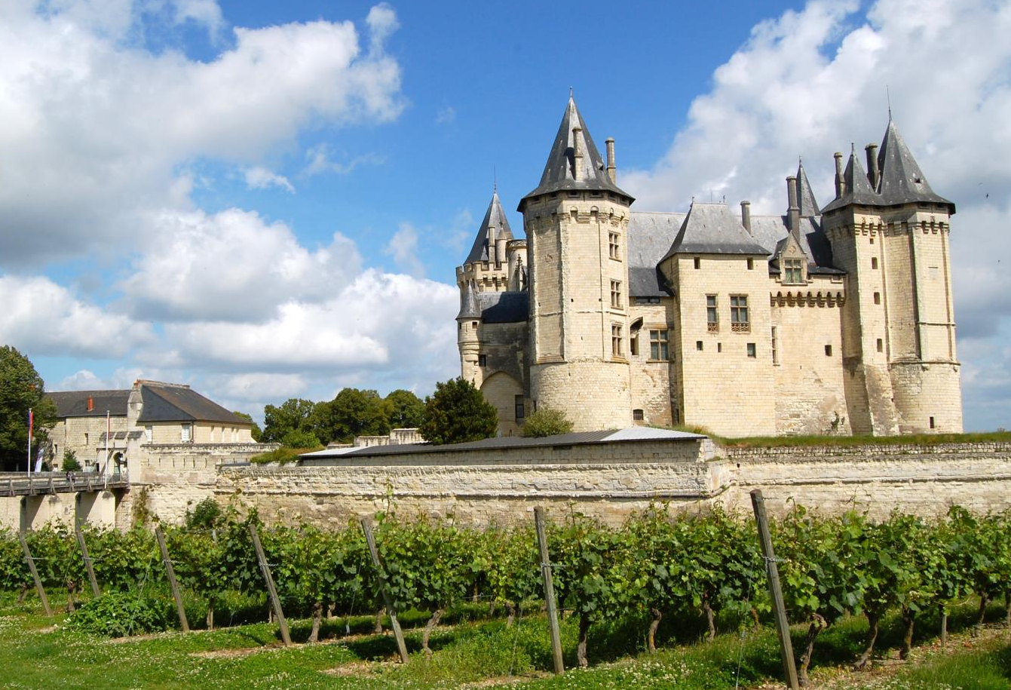
Notes:
The origin of Chenin Blanc can be traced to France’s Loire Valley. Chenin is also the Cape’s most widely planted wine grape variety. South Africa has double the hectares of plantings of Chenin compared to the Loire Valley.

Slide 3
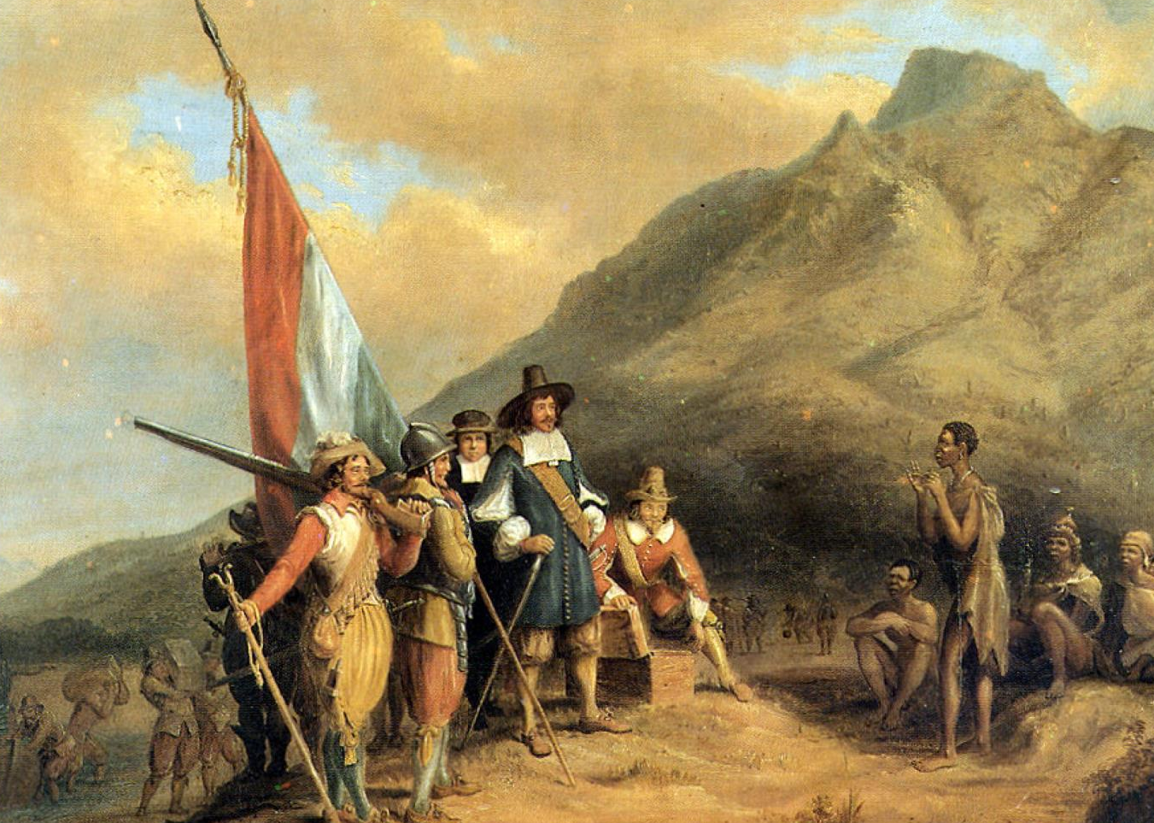
Notes:
It seems that Chenin Blanc was one of the first varieties to be introduced to the Cape. Jan van Riebeeck introduced the first vines to the Cape in 1655. Early documents refer to three varieties: Groendruif (Green Grape or Sémillon), Fransdruif (French Grape) and Steen (Stein). It seems that the origin of the names Fransdruif and Steen are intertwined.

Slide 4
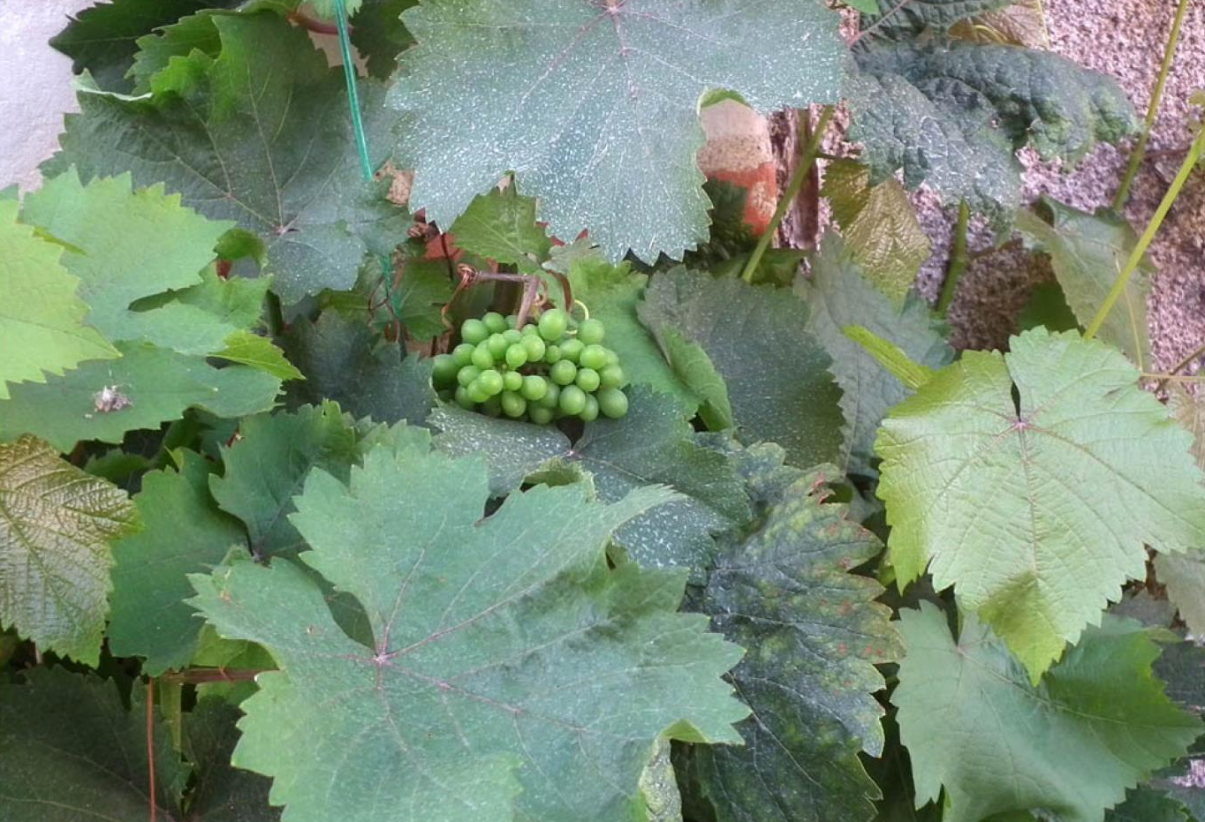
Notes:
In 1963, the then Head of Viticulture at the University of Stellenbosch, Professor CJ Orffer, matched Steen and Chenin leaves and finally pronounced that Steen was indeed Chenin Blanc.

Slide 5
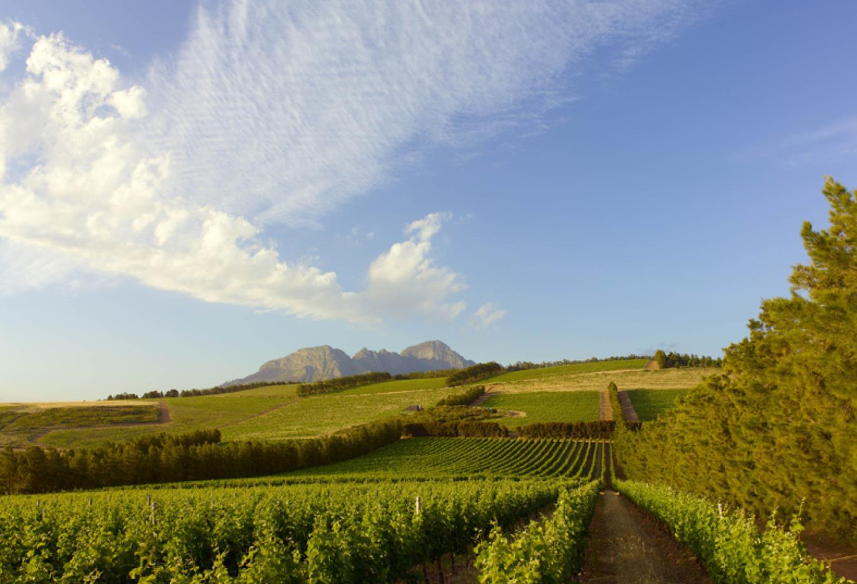
Notes:
Chenin was originally planted because of its resistance to disease, tendency to yield big volumes and versatility, which made it very much the workhorse of the industry.

Slide 6
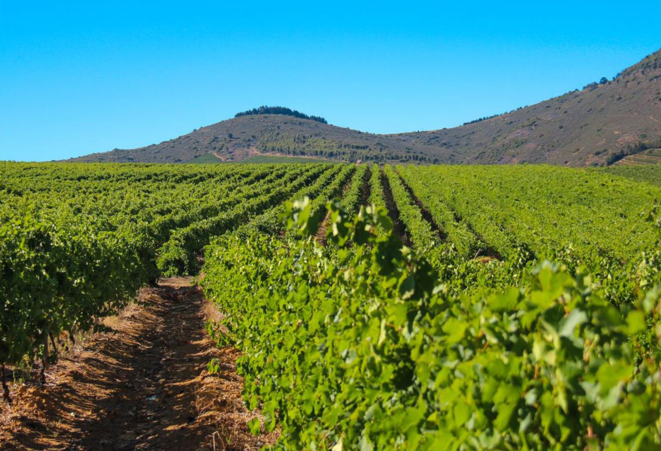
Notes:
Today, modern growers are raising the standard of Chenin to new levels.

Slide 7
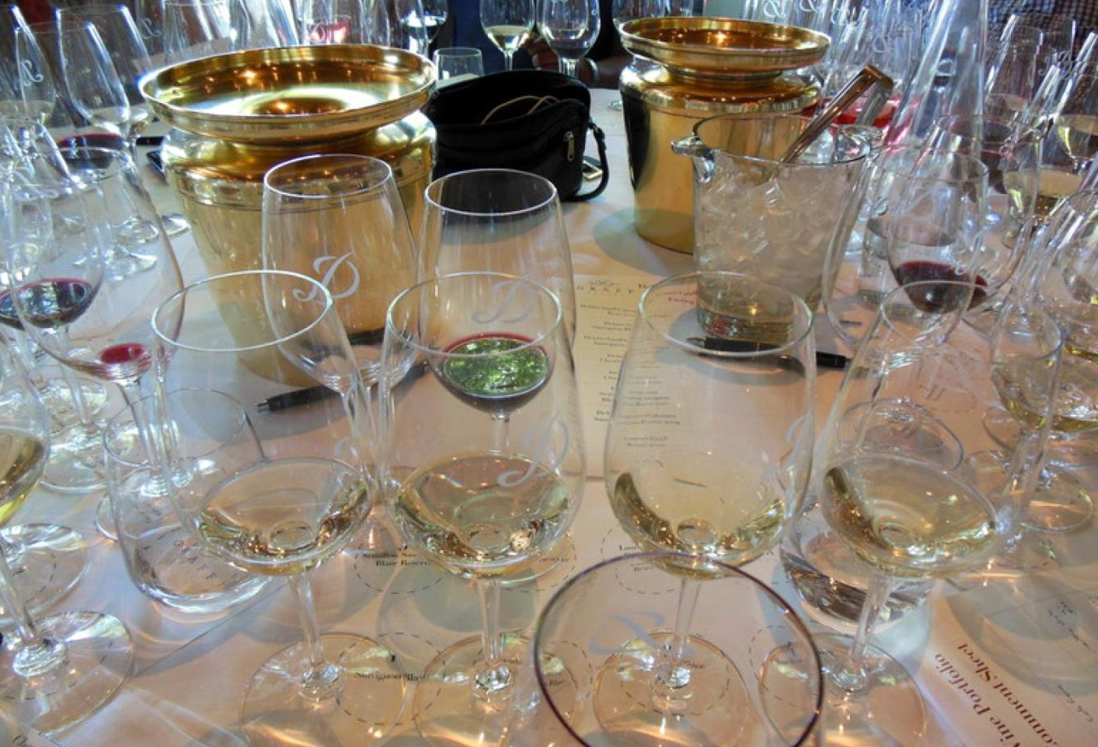
Notes:
In the mid-1990s an informal initiative known as the ‘Chenin Renaissance’ attracted a number of passionate producers who sought to elevate the reputation of the variety.

Slide 8

www.chenin.co.za
Notes:
In 2000, the Chenin Blanc Association (CBA) was formed, with its aim to ensure that South African Chenin Blanc takes its rightful place with the other great white wines of the world. Visit www.chenin.co.za for more information.

Slide 9
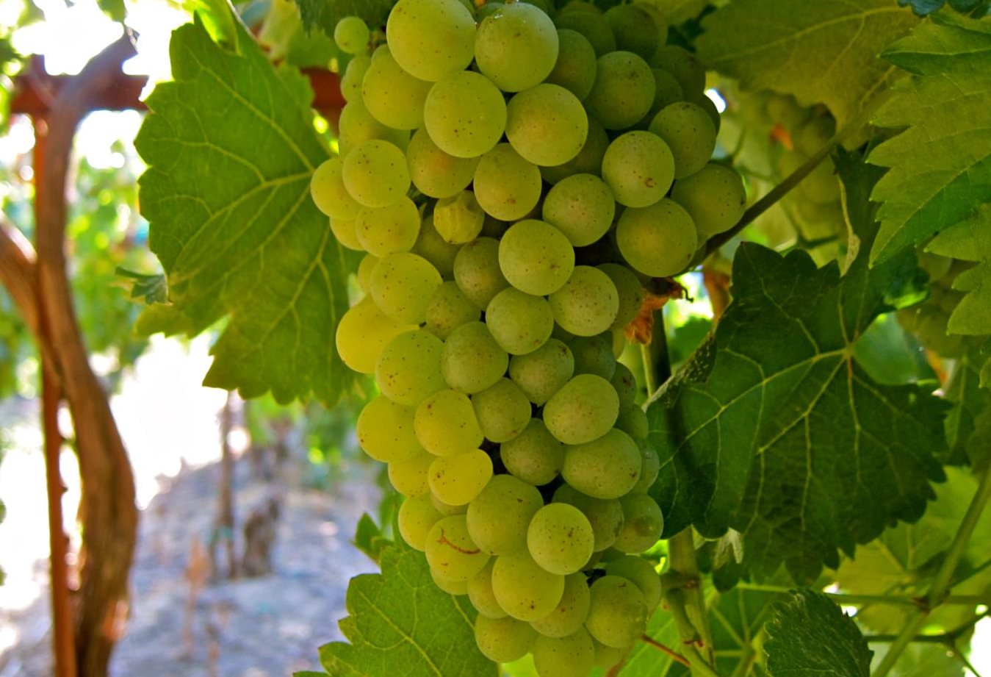
Notes:
A wide range of clones is available. These are carefully matched to site and desired style of wine.

Slide 10
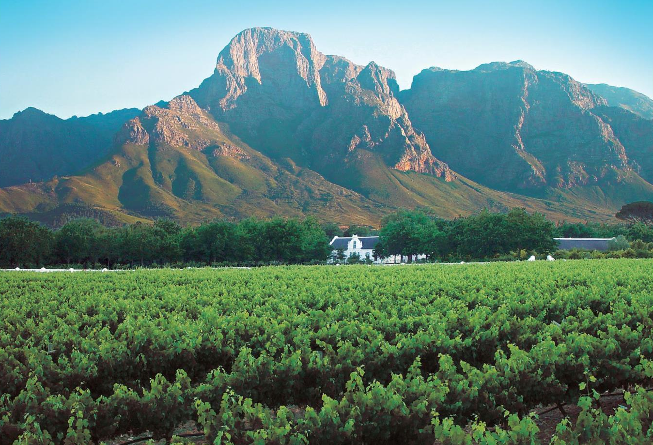
Notes:
Chenin Blanc is the most widely planted white-wine variety and the most planted variety overall, with total plantings in South Africa at the end of 2025 accounting for 15 949 ha (18.4% of the national vineyard).

Slide 11

Notes:
Although the most plantings are found in the Breedekloof, closely followed by Paarl and Olifants River, then the Swartland, Chenin is planted across the length and breadth of the winelands, and this diverse terroir provides fruit for a wide variety of styles.

Slide 12
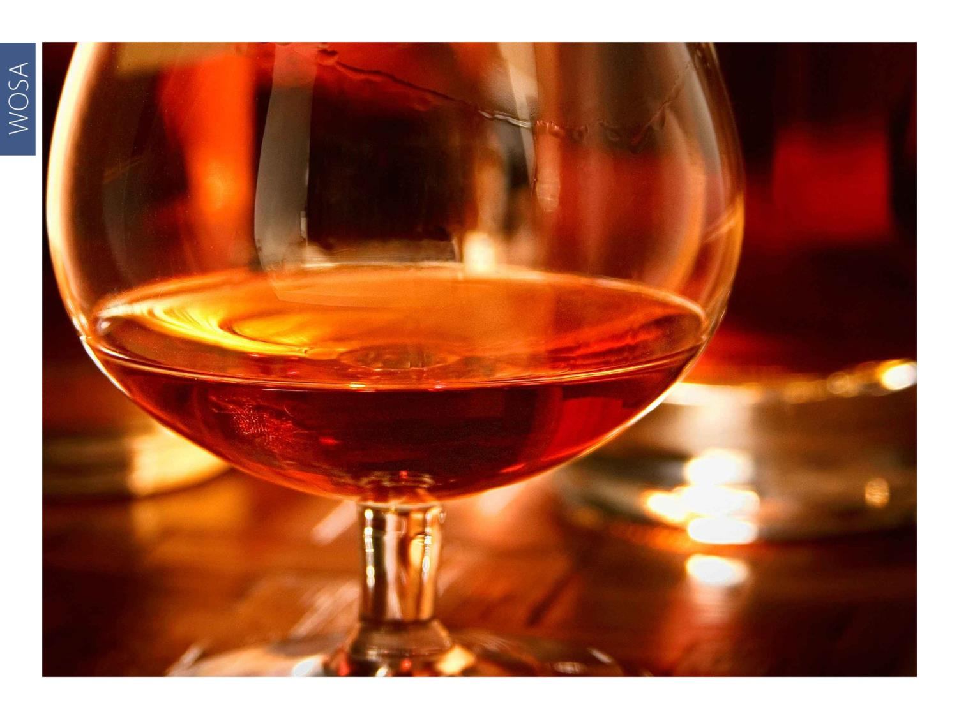
Notes:
Characterised by its versatility, Chenin produces good natural wines covering the whole spectrum from dry to sweet wines, as well as sherry and sparkling wines. It is also used for distilling brandy and spirits.

Slide 13
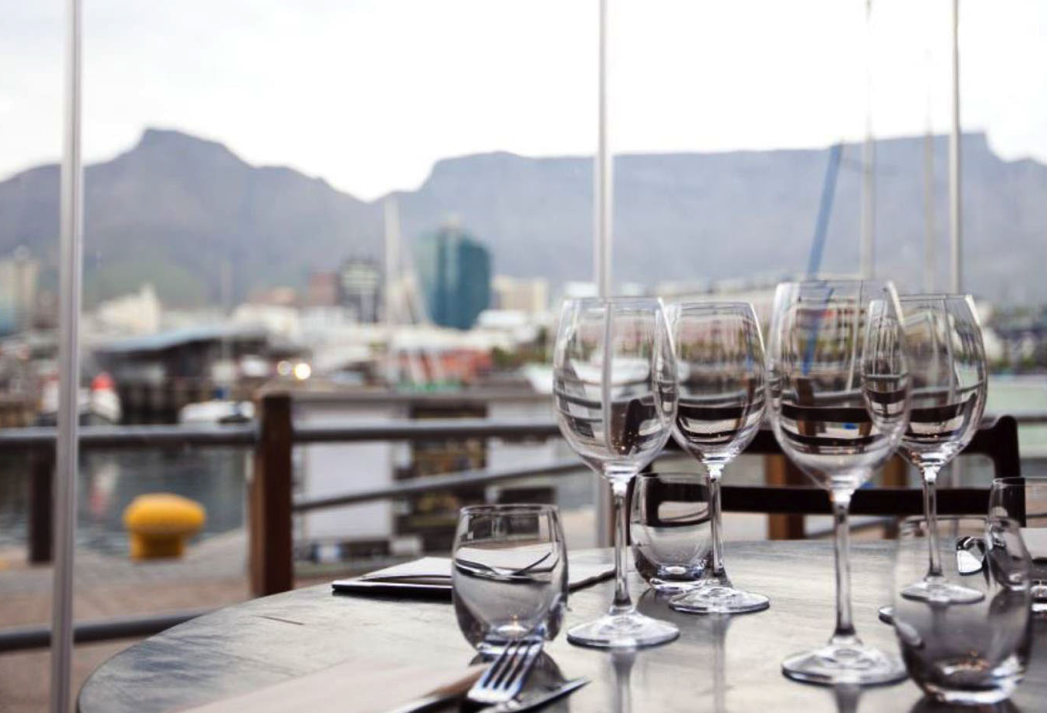
Notes:
The term Cape blend is mainly used for Pinotage-led red blends but it is also used occasionally for Chenin-driven white blends. Mediterranean-style Chenin-led blends are an increasingly strong category.

Slide 14
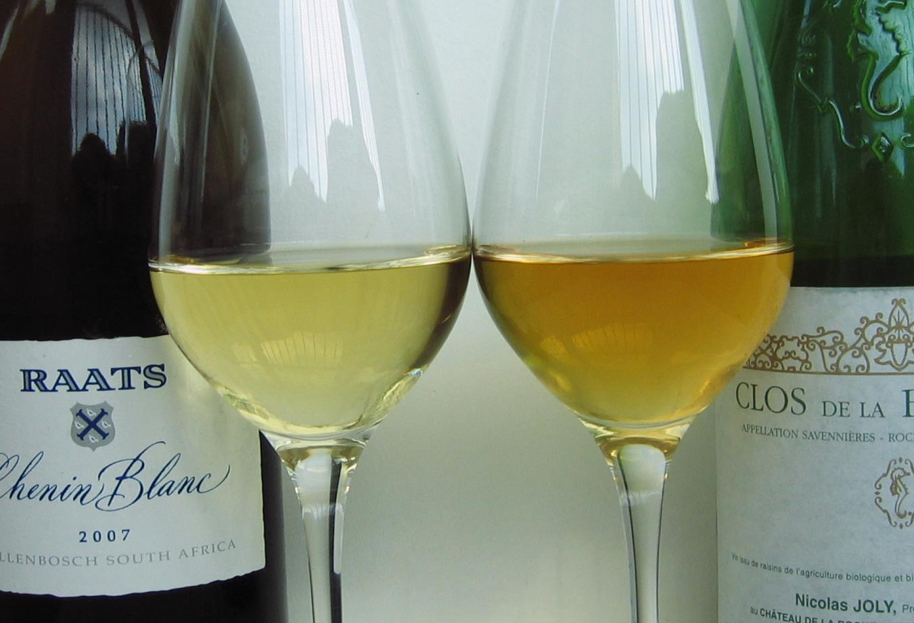
Notes:
The dry and off-dry wines present fresh, vibrant white fruits with a zesty and crisp finish, while full ripe, rich wines with oak barrel fermentation and ageing make for complex powerful wines. Yet other wine styles seen in South African Chenins are the oxidative style, sur lie/terroir driven with expression of local soil types, often perceived as minerality.

Slide 15
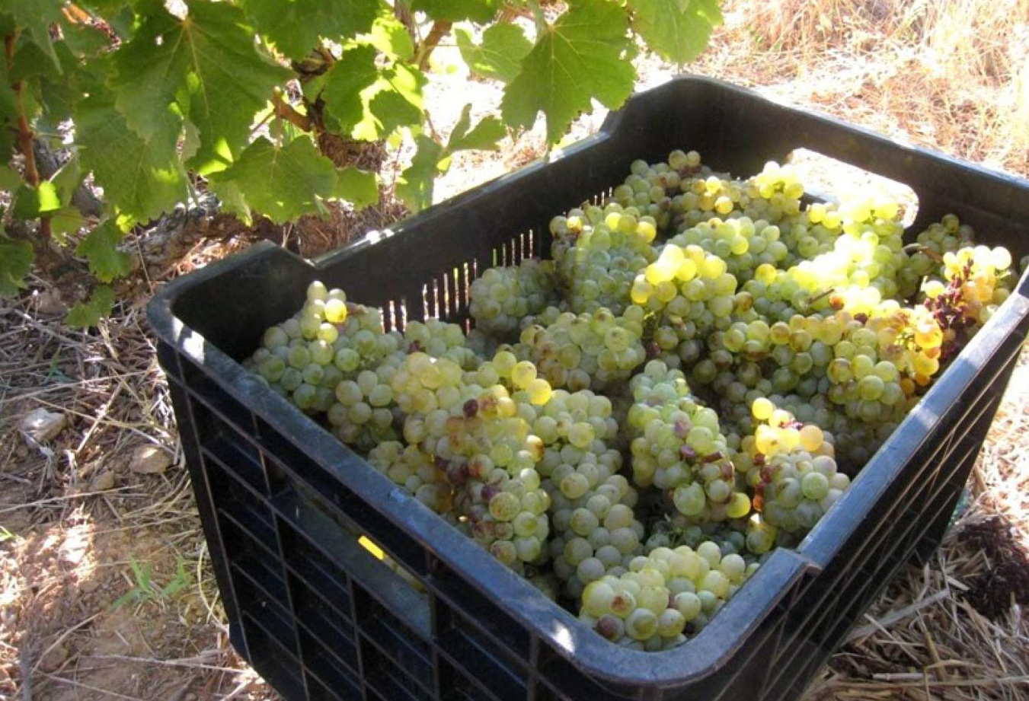
Notes:
Chenin is a very responsive variety and it will give back in the bottle what has been put into the vineyard and the cellar.

Slide 16

Notes:
Chenin’s fruitiness finds favour with a wide range of palate preferences.

Slide 17
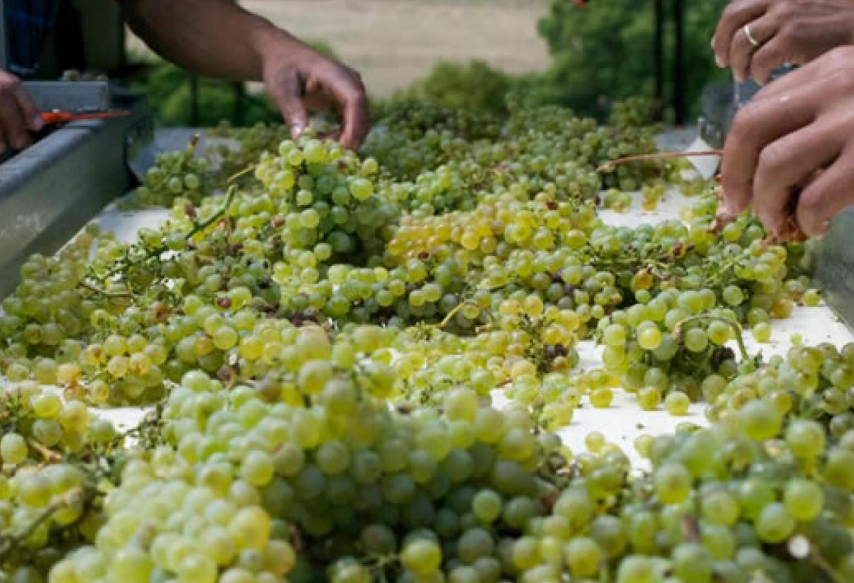
Notes:
While most South African Chenin wines are still made in a fresh and fruity style, that is changing.

Slide 18
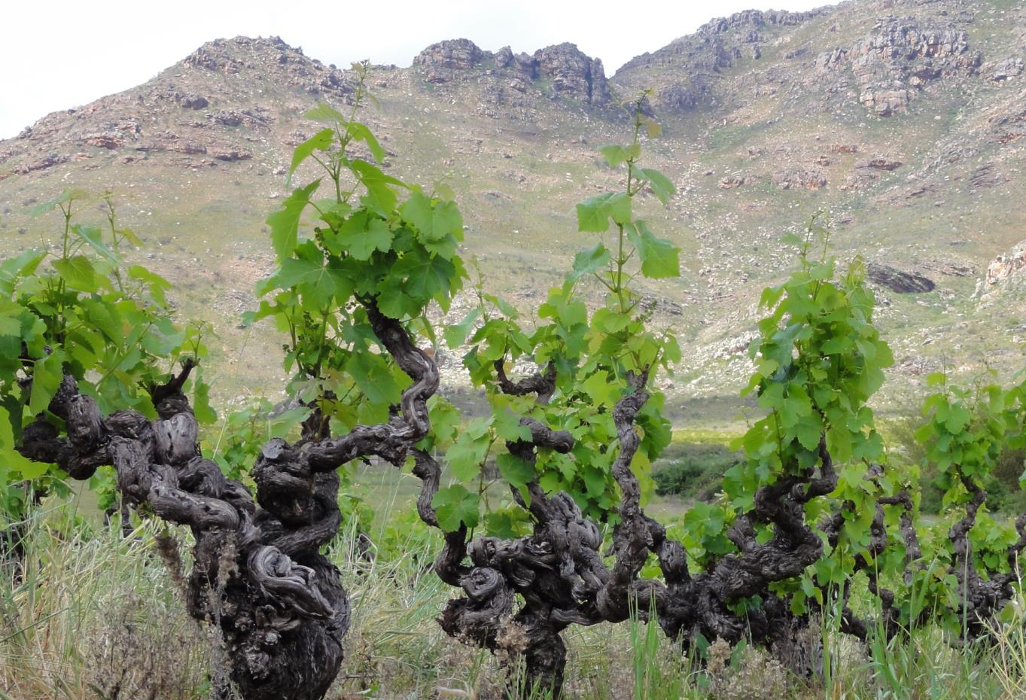
Notes:
More and more producers are focusing on mature bush vines, which are carefully managed for balanced yields. They are pruned dramatically to cut down on tonnage, the grapes are picked riper, and winemakers often introduce oak fermentation and maturation. Passionate proponents of the special intensity and complexity grapes from older vineyards can bring to a wine are preserving pockets across the winelands, for example in the Swartland and Franschhoek. Many of these Chenin vineyards are 35 years and more of age.

Slide 19
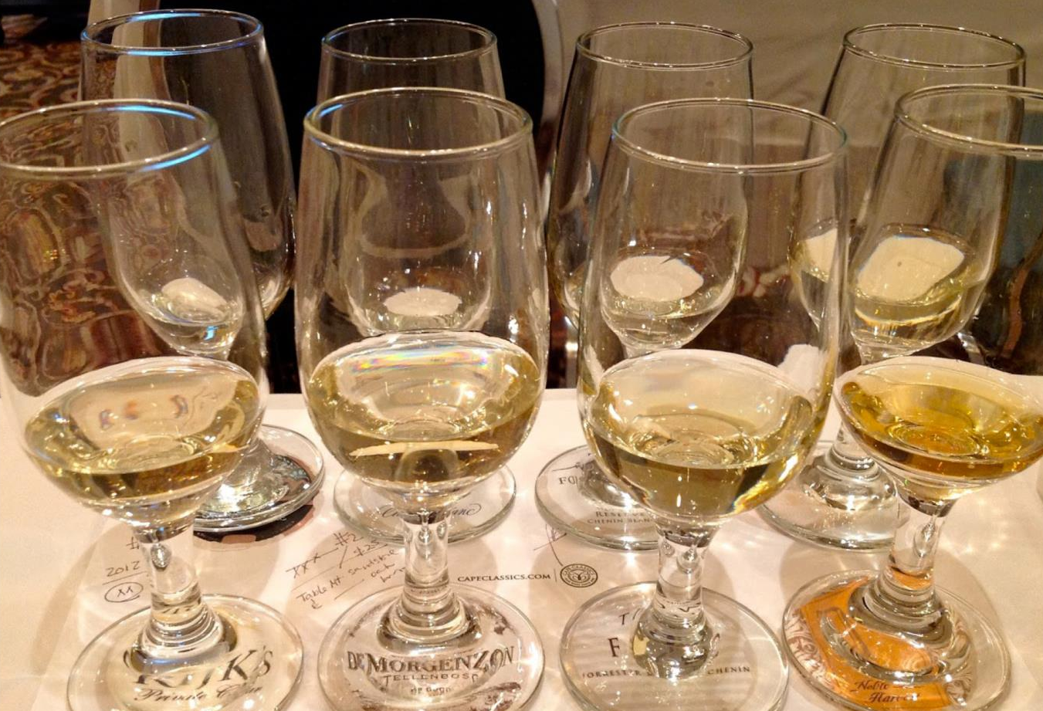
Notes:
The leading makers of the variety are constantly refining their approach and newer releases now show greater fruit purity and concentration, balanced by fresh but not overly marked acidity and less overt oak.

Slide 20
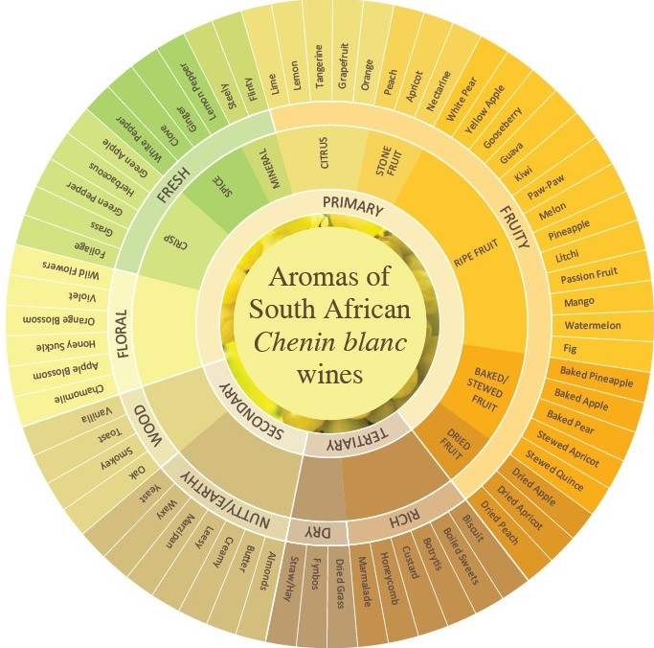
Notes:
Flavour profiles range from a light citrus or a more tropical fruit style to a richer and riper intensely fruity style. More complex aged Chenins sometimes display a honeyed characteristic.

Slide 21
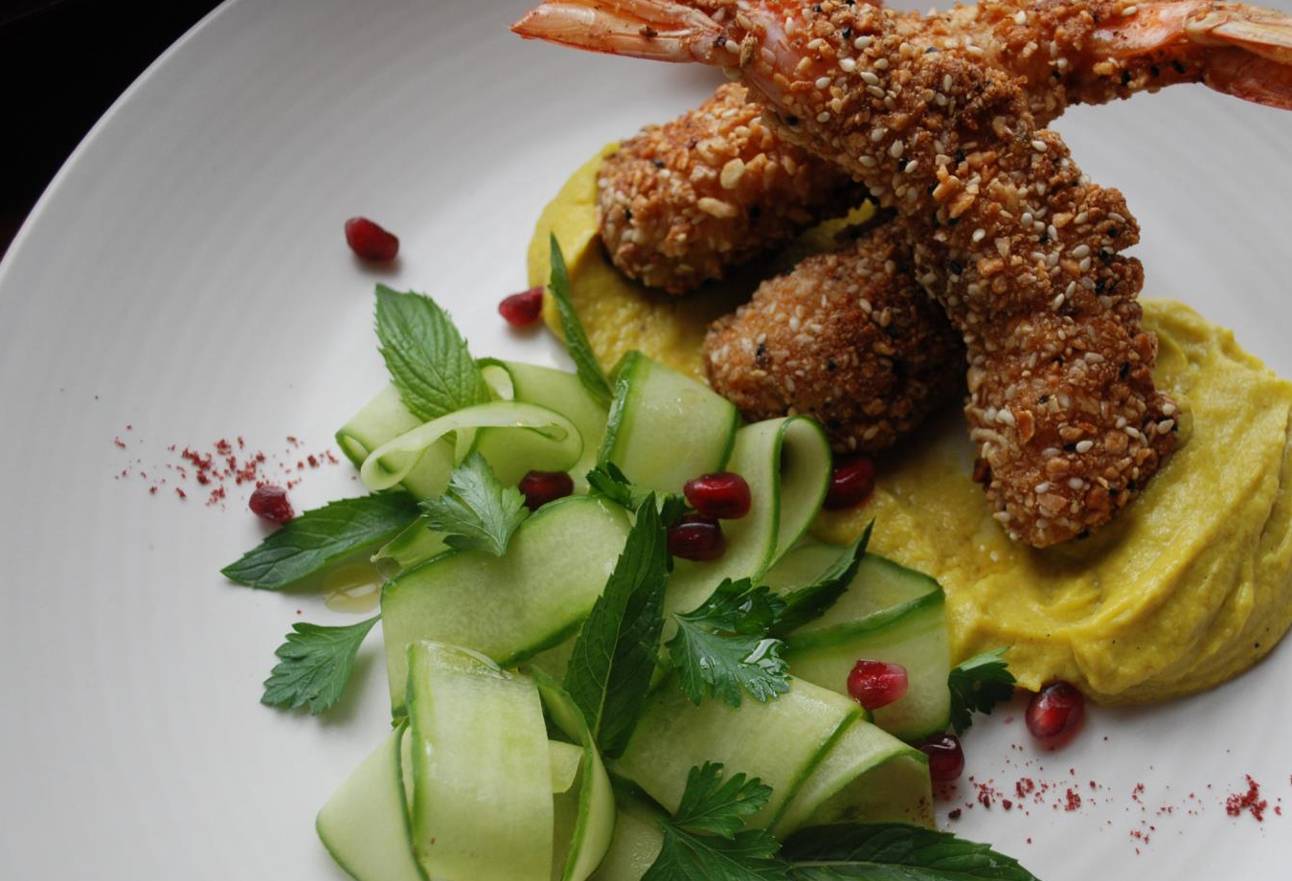
Notes:
This food-friendly wine is a good match for a wide choice of dishes but goes particularly well with spicy Asian cuisine, as well as poultry, seafood and sushi, creamy fish dishes and vegetable bakes.

Slide 22

“There is love for this grape and belief
in its versatility. And it is precisely
this diversity of offerings of Chenin Blanc
and regionally expressive wines that
tell the story of South Africa
and its heritage – in one grape.”
– Fiona McDonald, wine writer and international wine judge

Slide 23
The end
Notes:
The end

